Slide 1
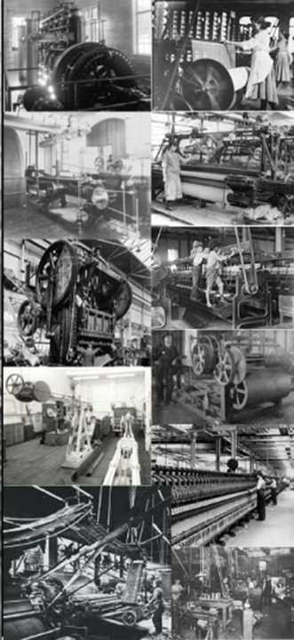
Industrialization
1865-1900

Slide 2
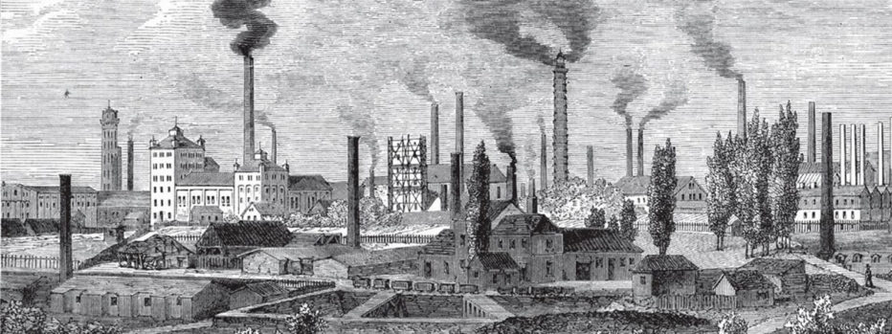
Innovation Questions
What was life like before the Industrial Revolution?
Who were the most influential inventors?
How did the Transcontinental Railroad promote growth?
What were the benefits of the Industrial Revolution?

Slide 3
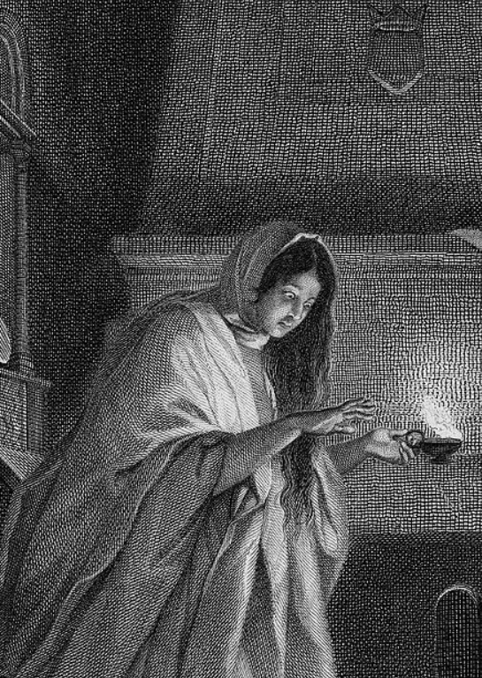
Industrialization
Daily life post-Civil War
No electricity
Slow communication
Time of innovation

Slide 4
Inventors
Thomas Edison - Phonograph
Eli Whitney - Cotton Gin
Wright Brothers - Airplane
Samuel Morse - Telegraph
James Hargreaves - Spinning Jenny
Edmund Cartwright - Power Loom
James Watt - Steam Engine
Elias Howe - Sewing Machine
Jean Lenoir - Combustion Engine
Alexander Graham - Telephone

Slide 5
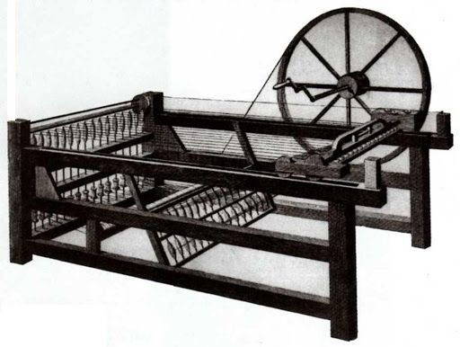
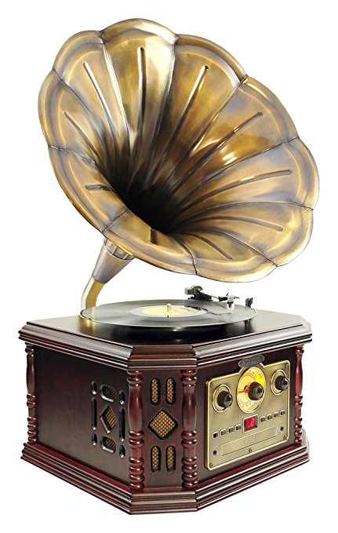
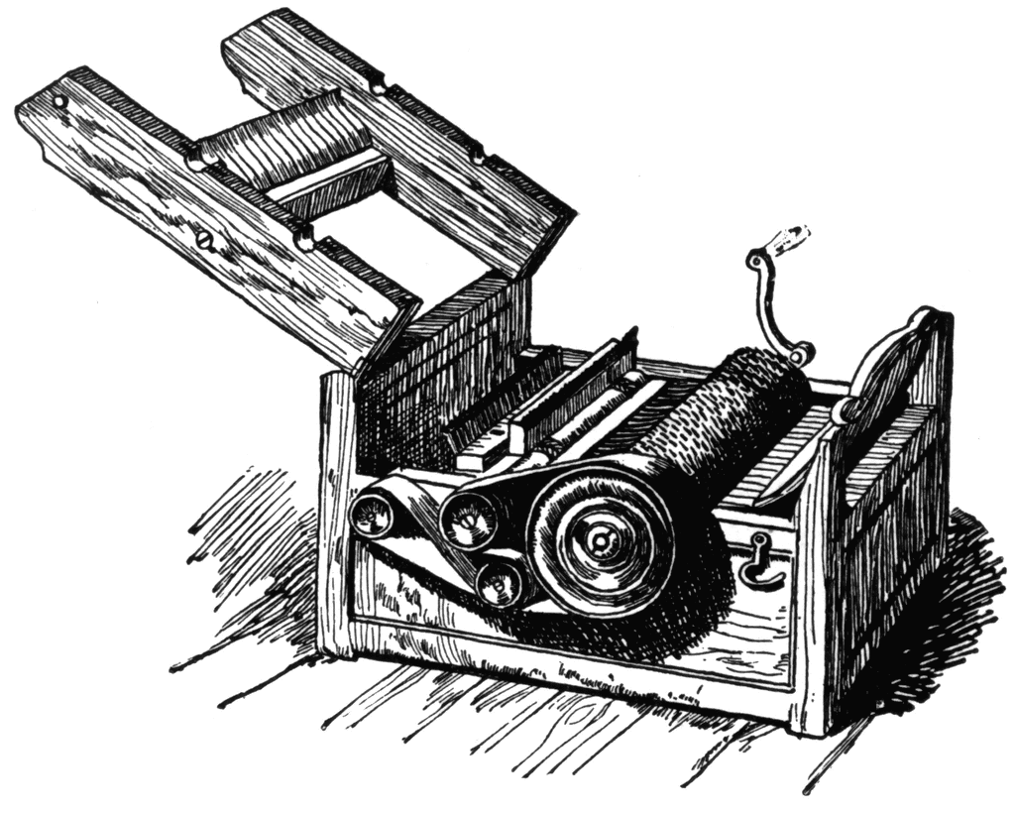
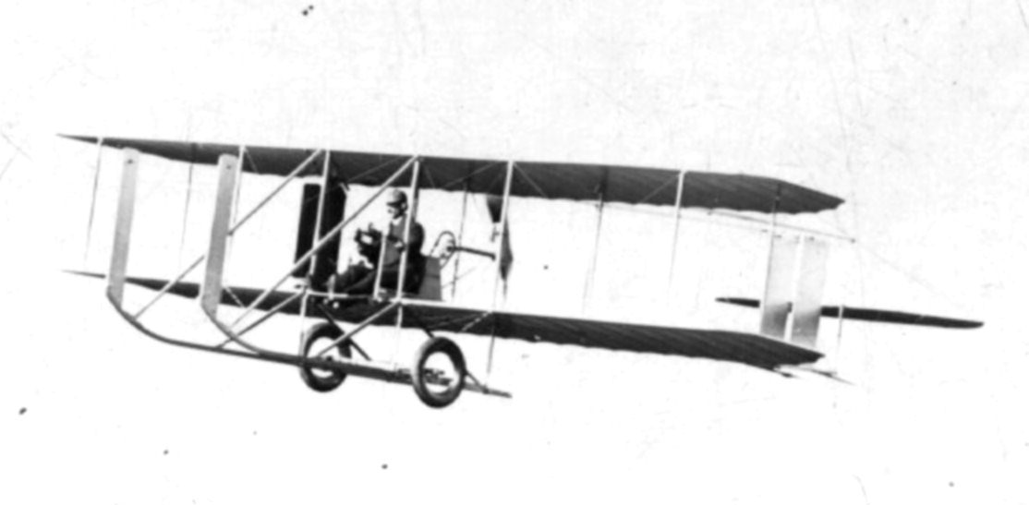
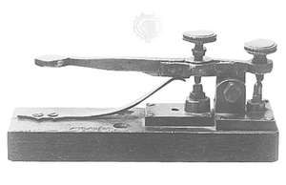
Inventions

Slide 6
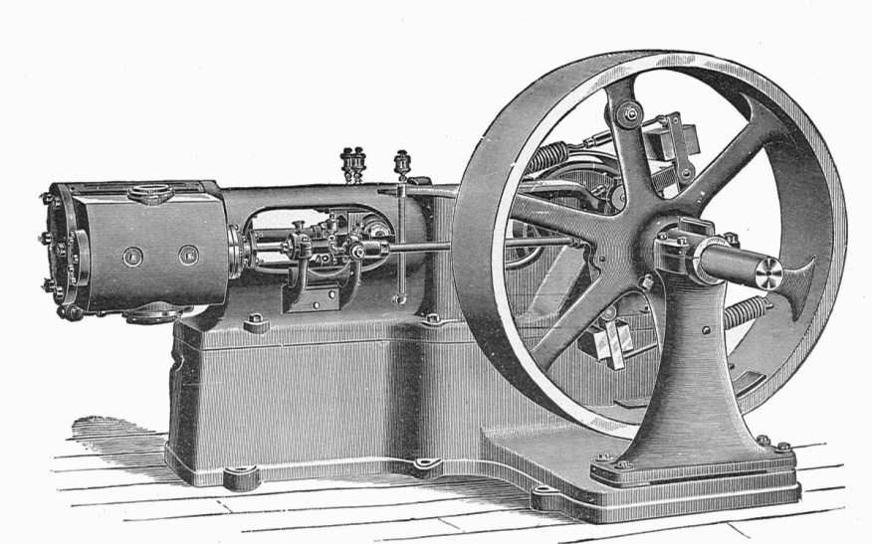
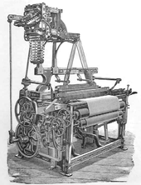
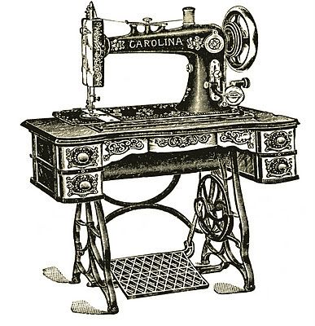
Inventions

Slide 7
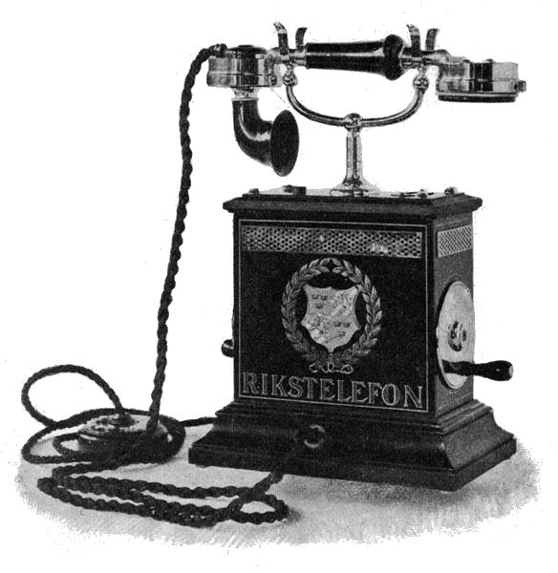
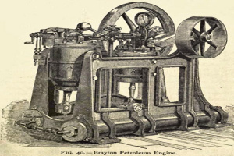
Inventions

Slide 8
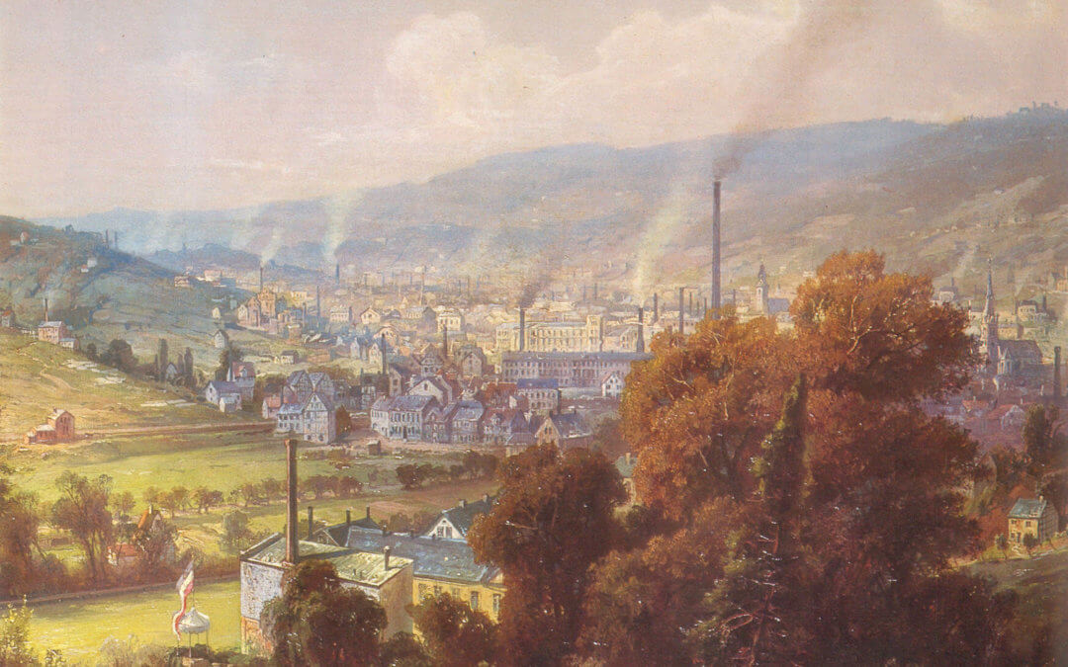
Inventions
Benefits to the new inventions
New inventions increased productivity
Longer workdays
More efficient communication across long distances
New industries

Slide 9
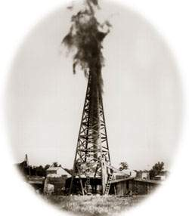
Energy Innovations
Oil
Old method – Whale fat
New method - Drilling
More efficient and less expensive
Increase supply of oil
Pennsylvania Rock Oil Company was the first to begin drilling in 1859
Oil was used to produce two things: Kerosene and Gasoline

Slide 10
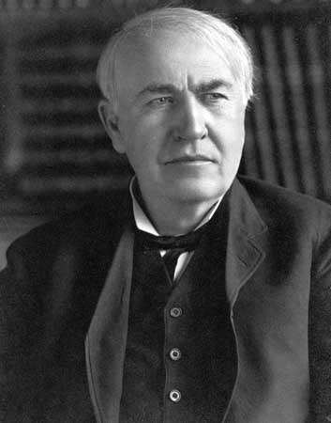
Energy Innovations
Electricity
Thomas Edison
Businessman and Inventor
First to use mass production on a large scale
Wanted power stations to spread electricity
His electricity was Direct-Current (DC)

Slide 11
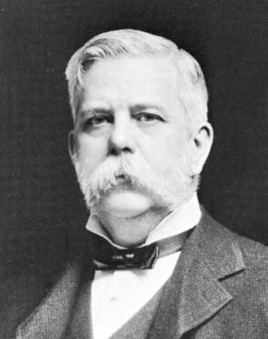
Energy Innovations
Electricity (cont.)
John Westinghouse
Experimented with Alternating-Current (AC)
Created the transformer to boost electric currents
Electric Companies:
General Electric (Edison)
Westinghouse Electric

Slide 12
Impact of Electricity
Electricity improved daily life
Refrigerators and other household appliances
Dramatic boost in business productivity
More factories
Cheaper and more efficient than oil
Less power to operate machinery than oil
Not available to everyone
Rural areas were out of reach
Electricity was cheap but appliances were expensive
Two Types
Direct Current
Alternating Current

Slide 13
Transcontinental Railroad
Old railroads were short and usually only connected nearby cities
The Transcontinental Railroad
Started in 1862
“Coast to coast”
Two companies funded by the government
Central Pacific Railroad
Union Pacific Railroad
Most workers were immigrants
Cheaper labor
Finished construction on May 10th, 1869

Slide 14
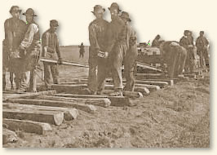
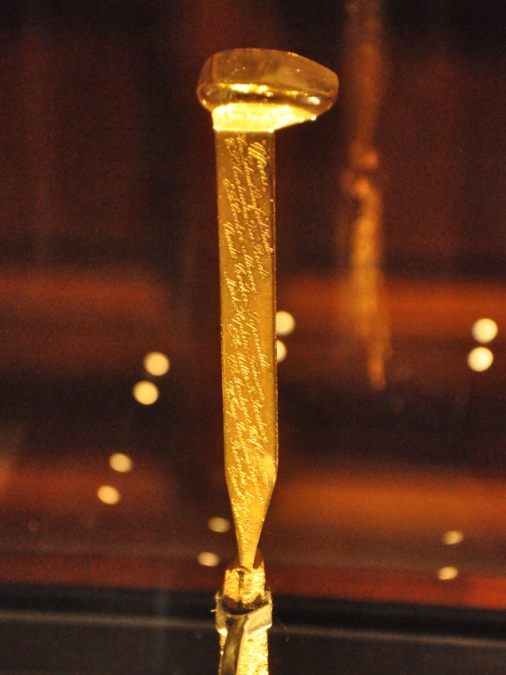
Railroads promote growth
Transportation was faster and cheaper
Lowered production costs
Nationwide markets
Expansion of businesses
Stimulated the economy and other industries

Slide 15
Other Innovations
Time Zones (1883)
Fix confusion and errors between train stations
Bessemer Process (1856)
More efficient way of creating steel
Mass production of steel
Led to more steel buildings
Bridges (1883)
Brooklyn Bridge was a faster and more convenient between Manhattan and Brooklyn
Previously, ferries were used

Slide 16
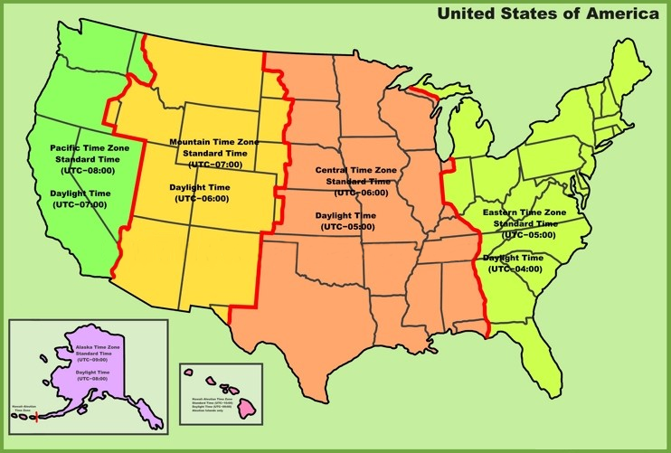
Time Zone Map

Slide 17
QUIZ!

Slide 18
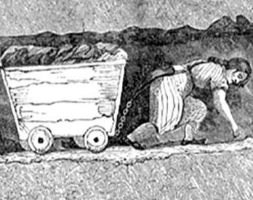
Business Questions
Who were John Rockefeller and Andrew Carnegie
What was the purpose of the Sherman Anti-Trust Act?
What is a Monopoly?
What is Social Darwinism?

Slide 19
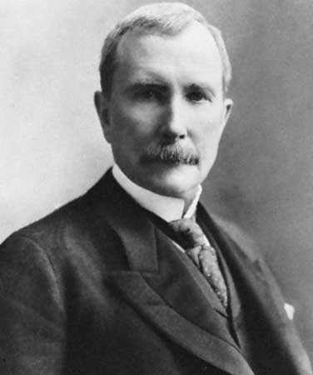
Big Business Growth
John Rockefeller
Created the Standard Oil Company in 1870
Donated a lot of money to charity
One of the most wealthiest Americans in the late 1800’s
Grew his company by being a “Robber Baron” and formed a Trust.

Slide 20
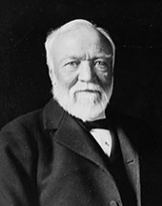
Big Business Growth
Andrew Carnegie
Created the Carnegie Steel Company
Later became the U.S. Steel Corperation
One of the richest men in the late 1800’s
Surpassed Rockefeller as the wealthiest American in 1901
Was considered a “Captain of Industry”

Slide 21
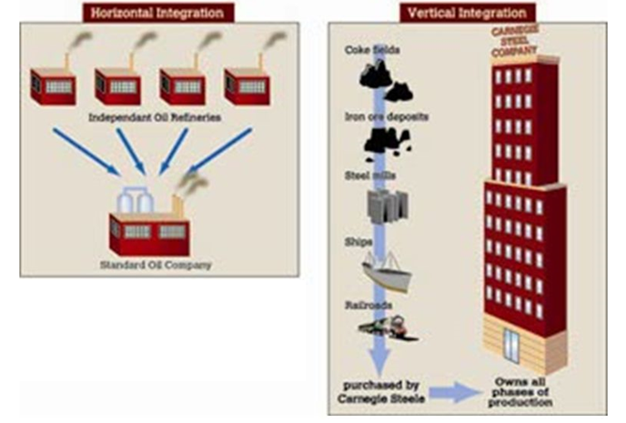
Business Consolidations

Slide 22
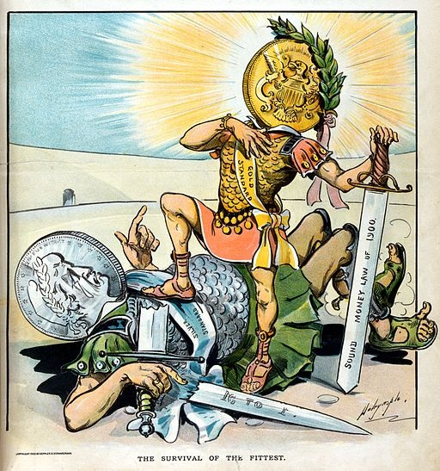
Social Darwinism
Society should not interfere with competition
Extension of Darwin’s theory of Evolution
“Survival of the fittest”
Believed in “weeding out” those unfit to become wealthy

Slide 23
Factors for New Businesses
More money needed to operate, requiring more investments
Expansion of railroads allowed access to wider regions
Combined various operations under one business
Owners hired more managers because of the size of the business

Slide 24
Business Types
Oligopoly
Ran by only a few companies
Lack of willing participants due to costs
Monopoly
Ran by one company
One company that buys out or drives out all of the competition
Complete control over prices
Cartel
A group of businesses that work together for a single product

Slide 25
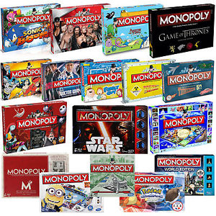
Monopoly

Slide 26
Government Response
Because trusts limited industrial competition, the U.S. Government intervened
Sherman Antitrust Act of 1890
Was supposed to restricted companies from forming Trusts that restricted trade
It was ineffective and poorly written
At this point in time, labor unions were seen as an economic burden

Slide 27
QUIZ!

Slide 28
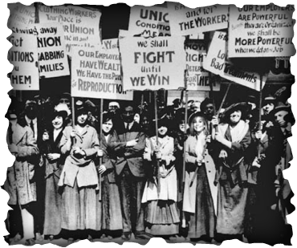
Labor Questions
What were conditions inside factories like?
Why are labor unions so important?
Why was Socialism so appealing?

Slide 29
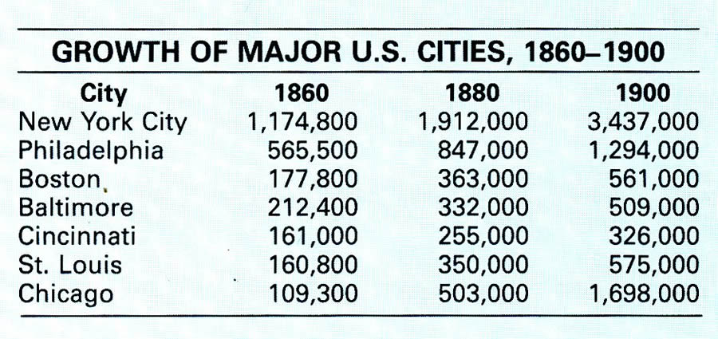
Work Force
Contract Labor Act
Grew the labor force
Contracted immigrant workers by paying their immigration costs
Dramatic increase in U.S. population
Some moved to cities from rural areas to find work, known as Population Shift

Slide 30
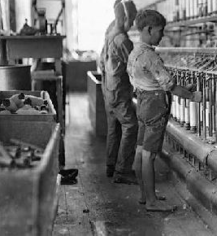
Factory Conditons
Long workdays
10 or more hours a day
Poor pay
Piecework
Pay based on how many items made
Dangerous work conditions
Sickness and injuries happened often

Slide 31
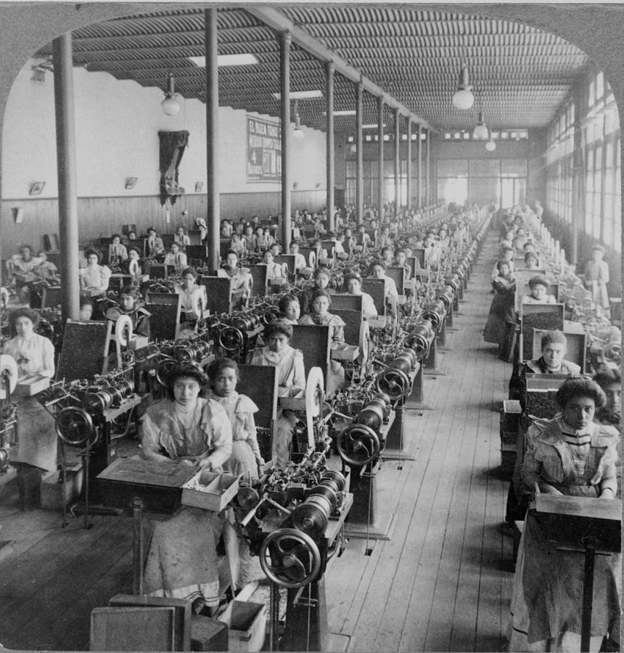
Factory Improvements
Over time:
Efficiency increased
More done with less effort
Did not always lead to more pay
Labor was divided (Division of Labor)
Individual work focused on one aspect
A different environment
Work was done at a fast pace
Pay reductions for inefficient workers (or fired)

Slide 32
Child workforce
1880’s – 5% of workers were children
20% over the age of 10 worked
Children helped provide for their families
Usually when poor or a parent died
Sometimes left school around age 12 – 13
Hazardous conditions
Sick and injured often
Grime, dirt, grease

Slide 33
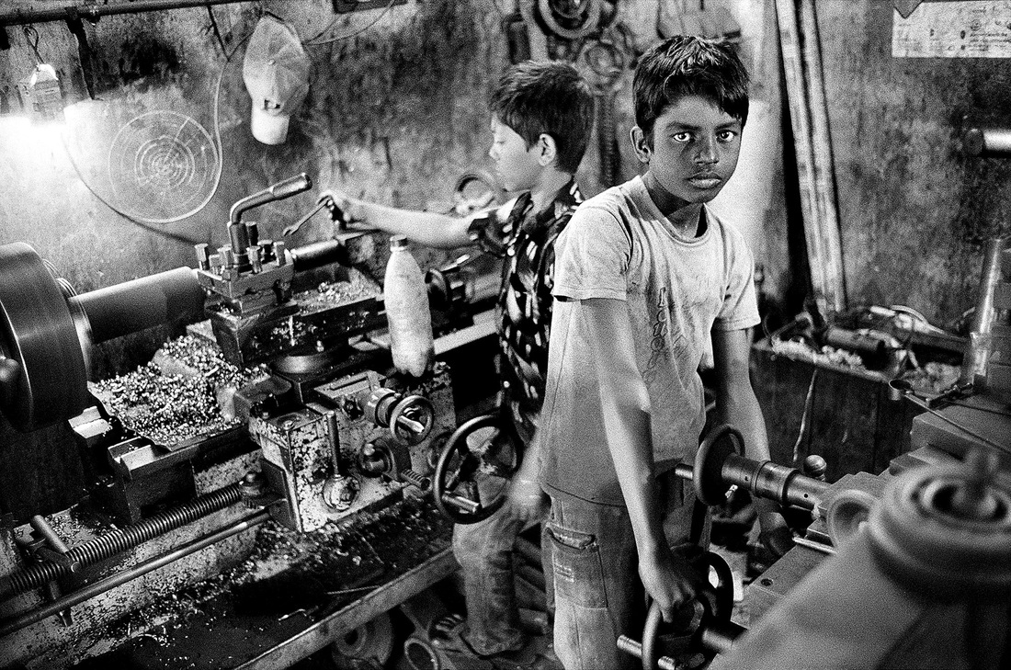
Child workforce

Slide 34
Wealth Divide
1890’s - average workers made around $100 a year
The gap between the poor and the wealthy
Many became interested in Socialism
Philosophy that wealth should be divided evenly
Others wanted to keep what they worked for instead of sharing

Slide 35
Labor Unions
National Trades Union (1837)
First worker’s union in the U.S.
Lasted only a few years
National Labor Union (1866)
Had 60,000 members
Ended in 1872
Knights of Labor (1869)
African Americans and Women
Ended in thr 1890’s
American Federation of Labor (1886)
Craft union with 250,000 members
Wanted a “closed shop”
The Wobblies (1905)
Socialist labor union
Focused on unskilled workers

Slide 36
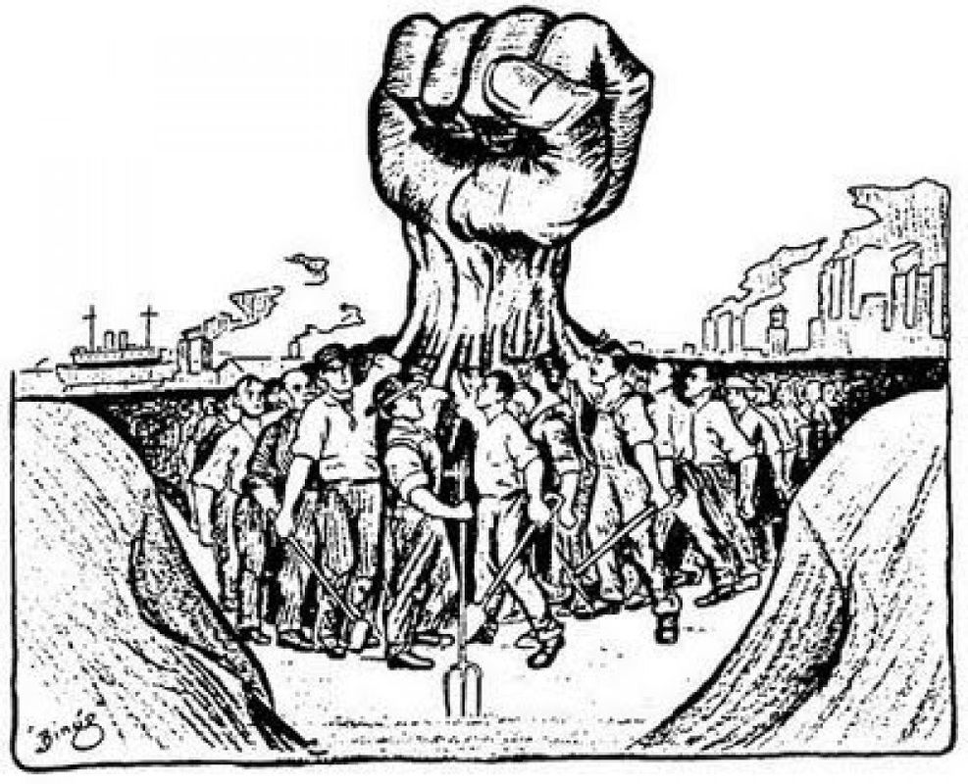
Labor Unions

Slide 37
Employers vs unions
Employers did not like labor unions
Higher wages meant higher costs
Less profits
Reactions:
Forbid labor meetings
Fired union organizers
Forced workers to sign a non-union contract
Can’t join a union and can’t strike
No collective bargaining
Did not recognize unions as representatives

Slide 38
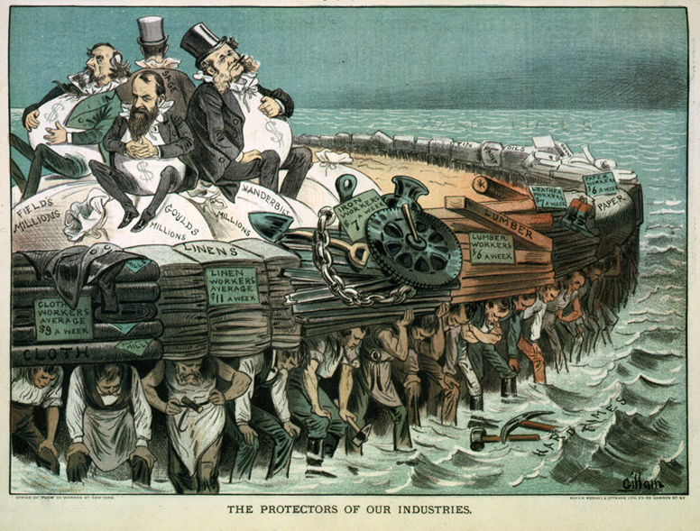
Employers vs unions

Slide 39
The great strikes
The Great Railroad Strike of 1877
Baltimore and Ohio Railroad company cut pay
Increase in train accidents and layoffs
Federal Troops were called in to calm the riot
Led to the creation of industrial unions
Haymarket Riot of 1886
Workers wanted eight hour work days
Fighting between the strikers and scabs
Molotovs thrown at police
Gunfire from both sides killed many

Slide 40
The great strikes
Homestead Strike of 1892
Carnegie Steel workers on strike
Gunfight between strikers and private security
Assassination attempt against Henry Frick
Pullman Strike of 1894
Another railroad strike in the town of Pullman
Less pay, people fired, high prices
260,000 workers joined the strike around the country
The strike was court ordered to end by the Sherman Antitrust Act

Slide 41
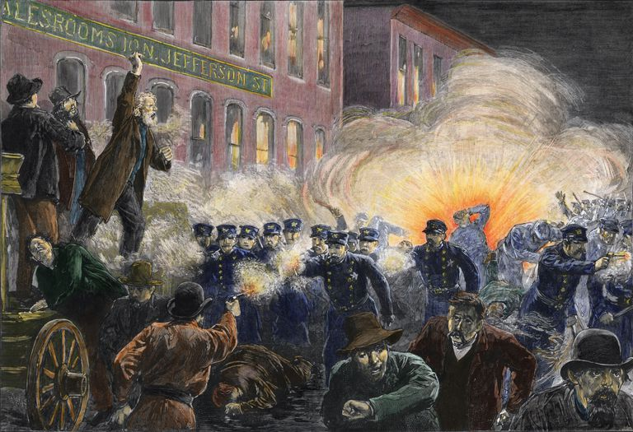
The great strikes

Slide 42
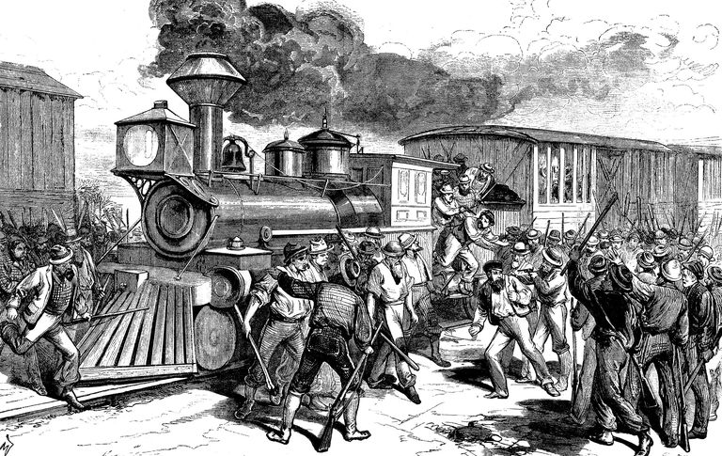
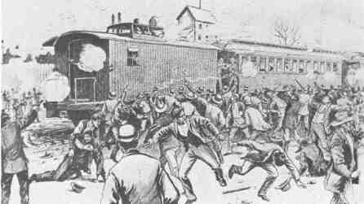
The great strikes

Slide 43
QUIZ!

